Slide 1
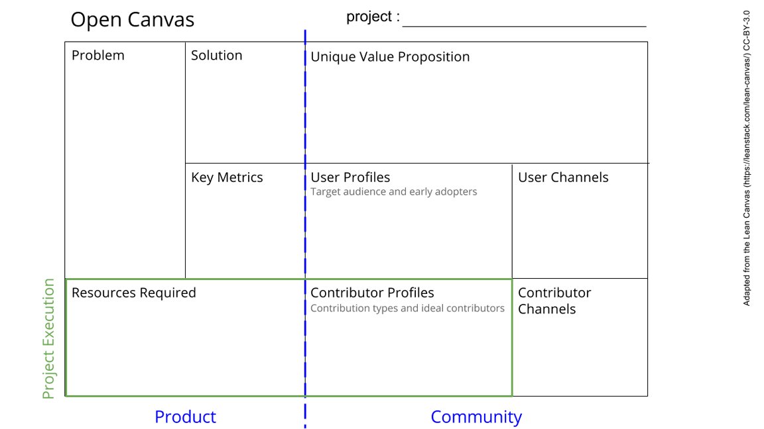
From invisible to visible: Apparent Age for Primary School children without birth certificates
Lack of knowledge of the procedure, but also structural problems ,
- The development of parallel registration channels,
- The lack of simplification of the registration and age reconstitution system.
Develop a system to determine apparent ages to be used by municipalities.
A Unique digitalised solution that will simplify the process of birth certificates delivery by including the 4 major stakeholders which are the parents, the court, the hospital and the mayor.
Increase in the number of birth certificates delivery
Doing research project with people from different backgrounds and expertise is the most exciting things in science
Municipalities
Hospitals
Justice court
Schools.
First requirement is a database,
Bioinformatics tools, Galaxy is a great resources. Data collection resources, and contributors
Data scientists, developers, medical doctors, municipal administrators, school administrators.
Collaborations through direct chats with stakeholders
Notes:
Go to File > Make a Copy… to make your own canvas
See next slide for instructions

